Slide 1
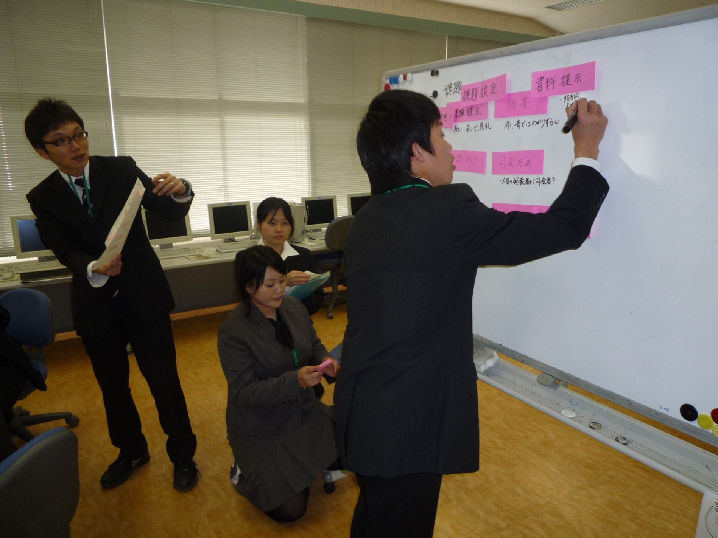
Tomoko TAMURA
The representatives of the groups make critical comments about the lesson and make larger labels on which they have written their opinions.
The chair puts the larger comment labels in order.
Notes:
The representatives of the groups make critical comments about the lesson and make larger labels on which they have written their opinions.
The chair puts the larger comment labels in order.

Slide 2
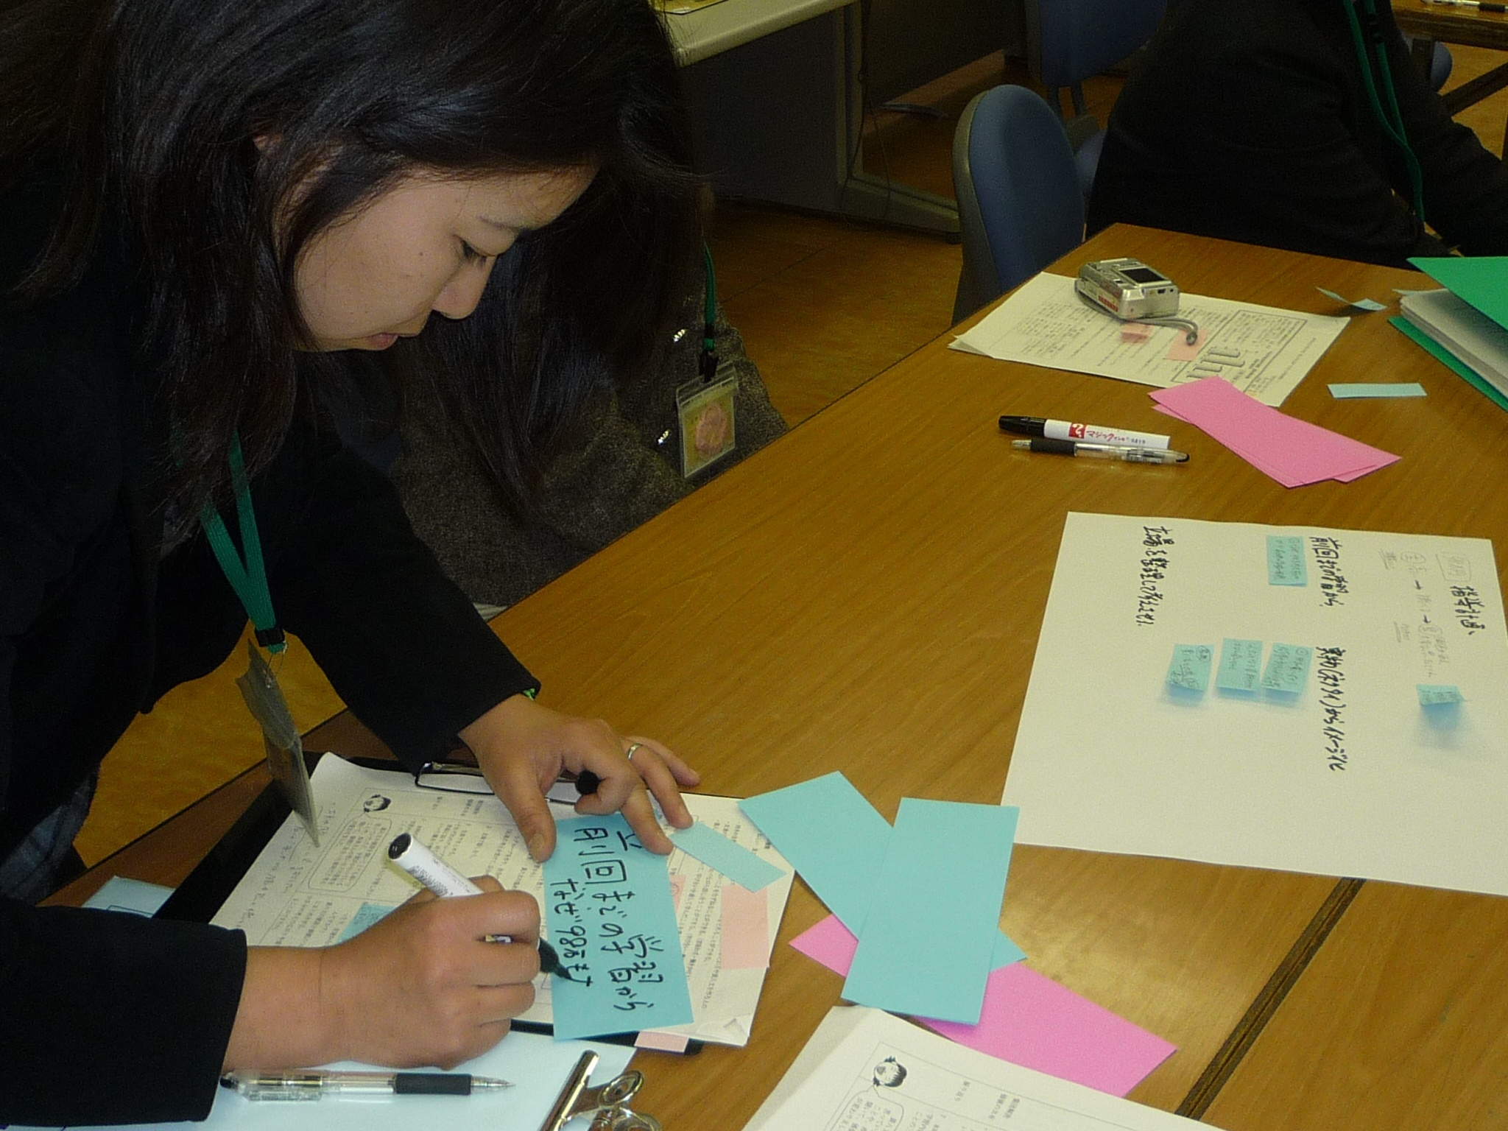
After this critical discussion, they discuss in small groups again.
At this time, they discuss how they can improve the research lesson.
They write down their suggestions on blue labels.
Tomoko TAMURA
Notes:
After this critical discussion, they discuss in small groups again.
At this time, they discuss how they can improve the research lesson.
They write down their suggestions on blue labels.

Slide 3
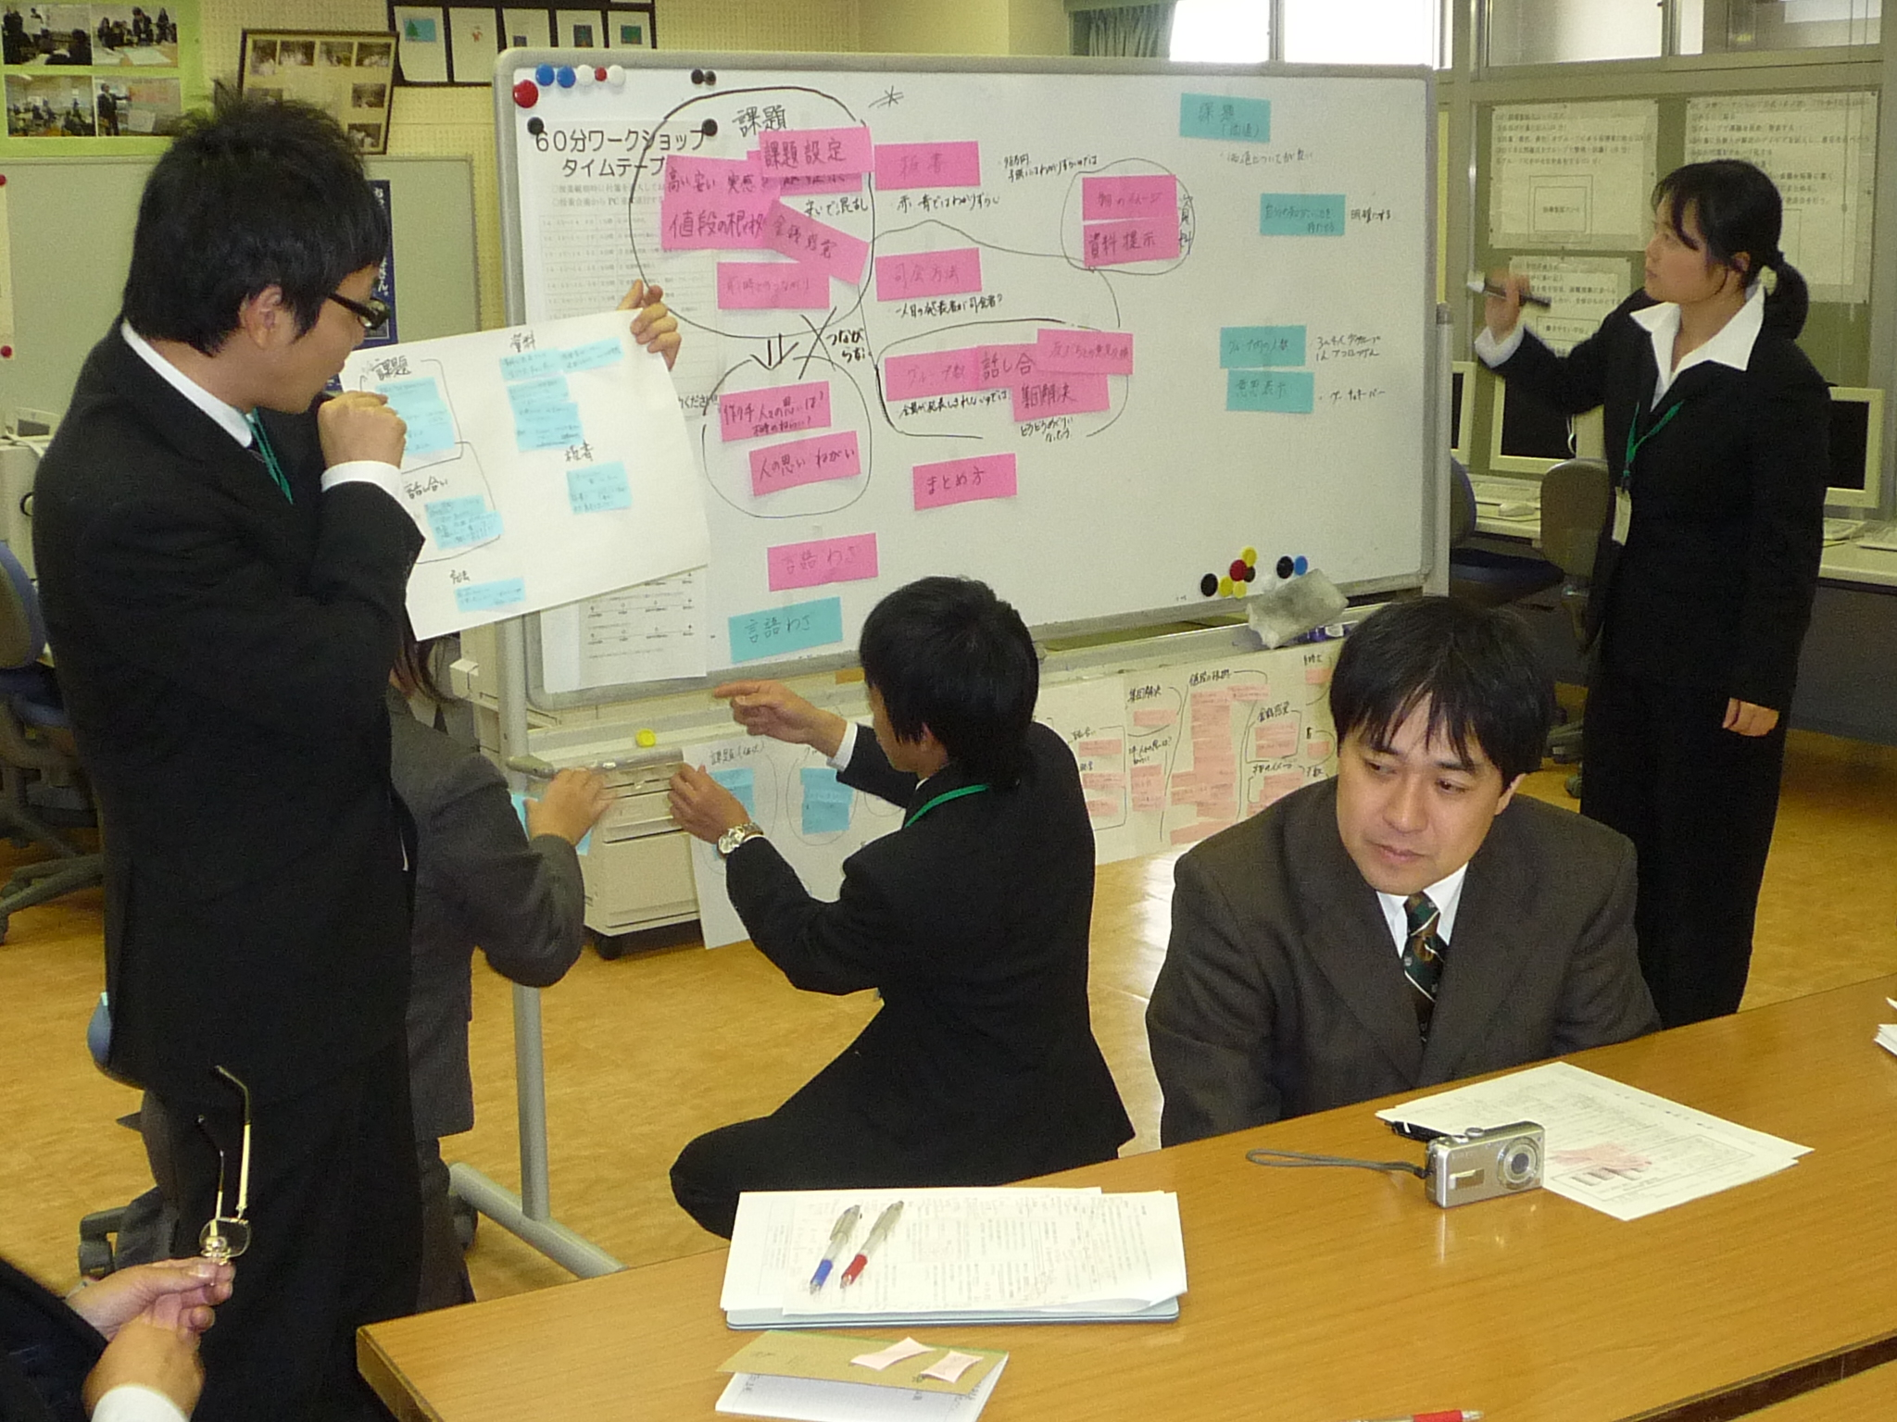
Tomoko TAMURA
The representatives of the groups offer ideas on how the research lesson can be improved.
The chair puts the larger comment labels in order.
Notes:
The representatives of the groups offer ideas on how the research lesson can be improved.
The chair puts the larger comment labels in order.

Slide 4
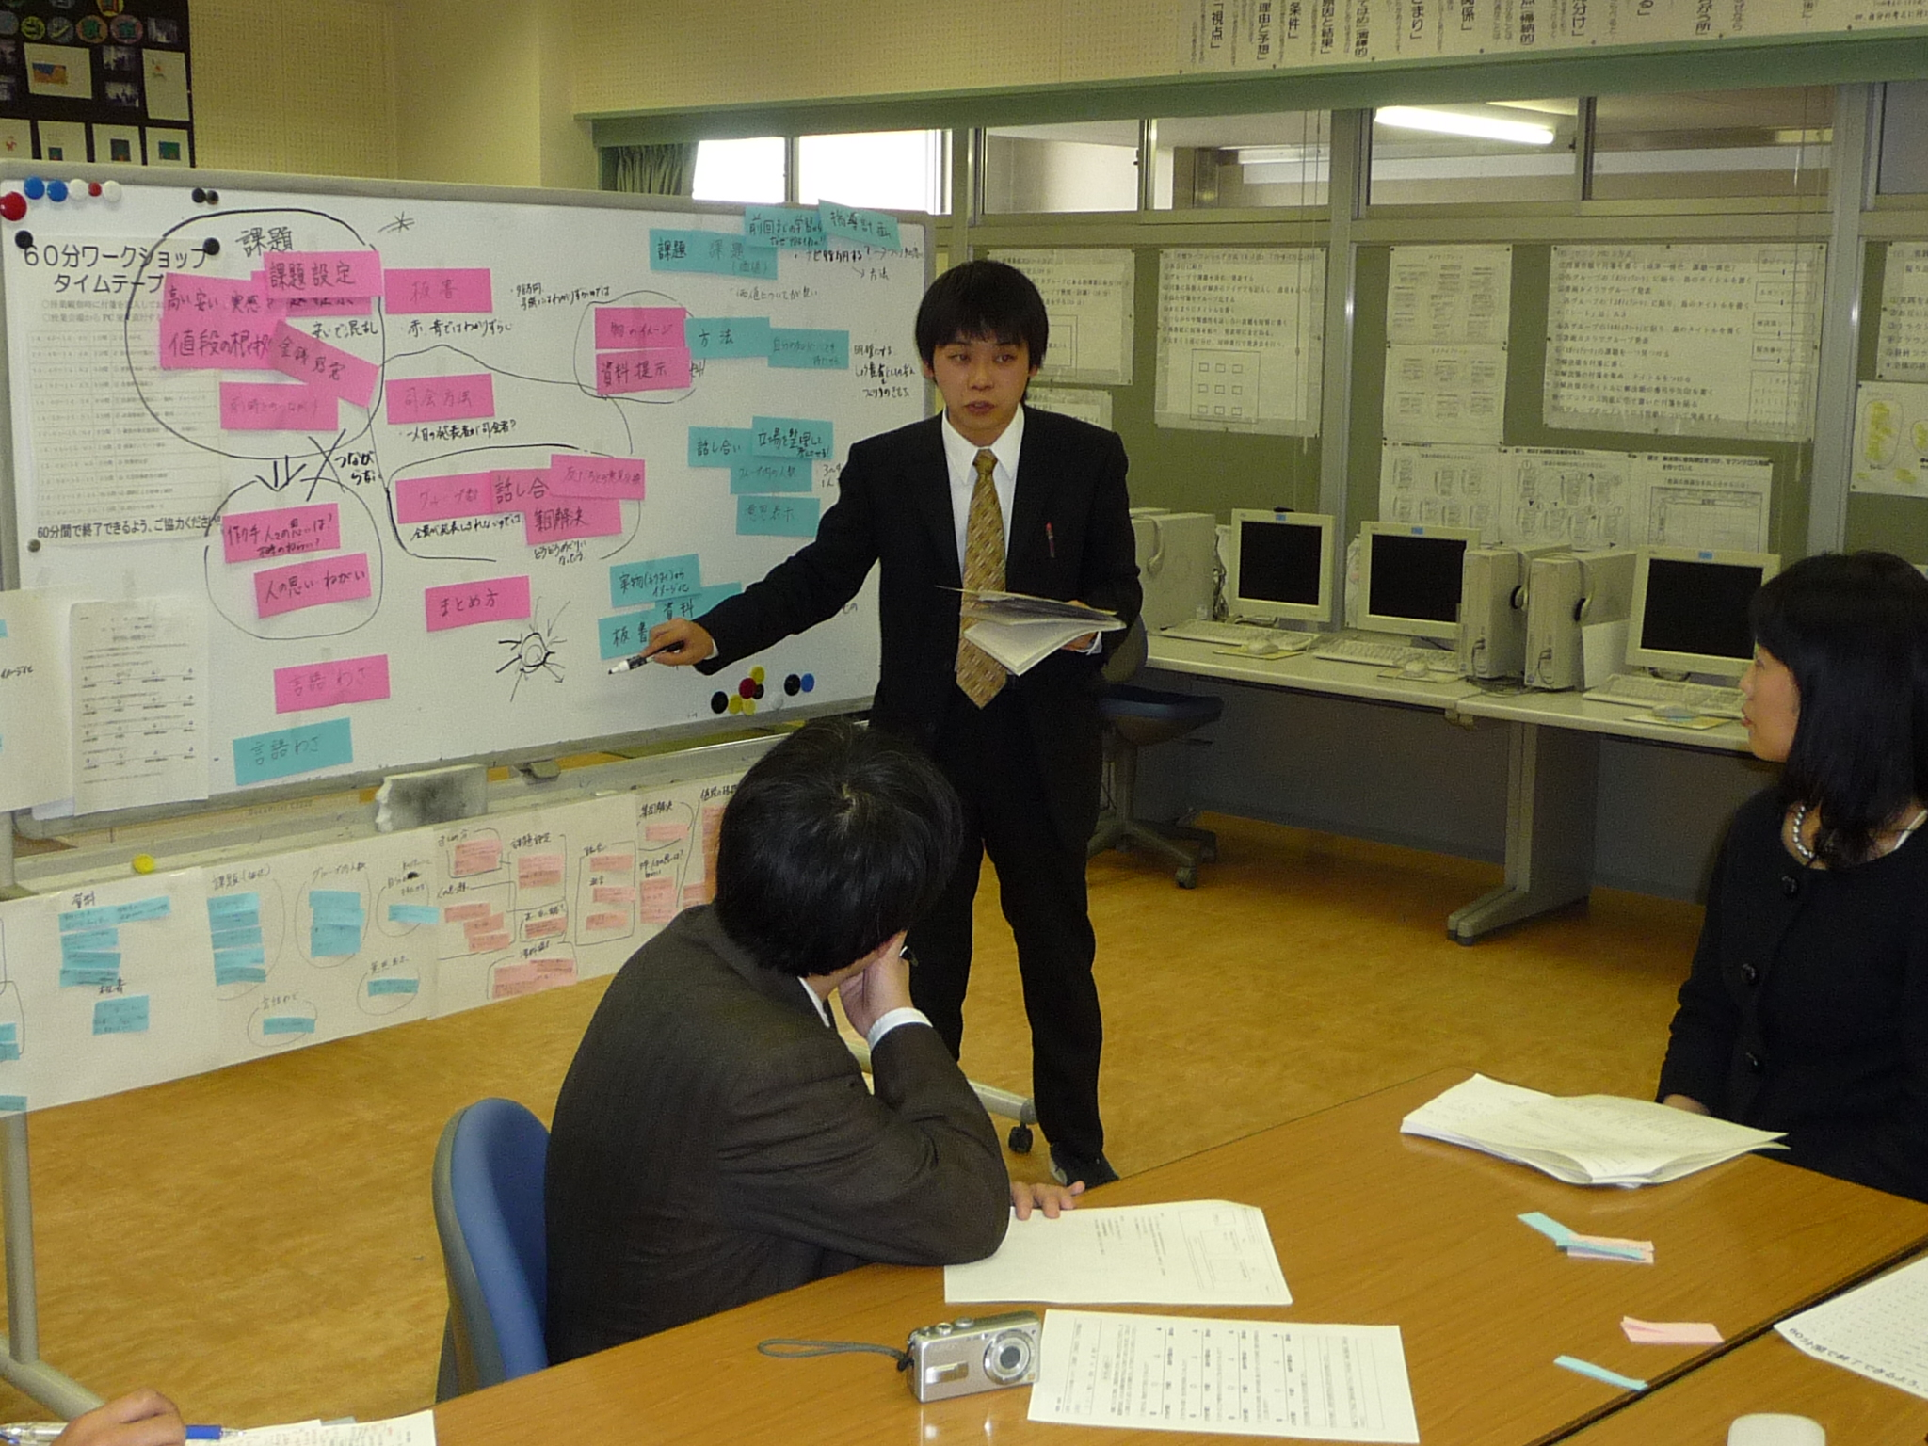
Tomoko TAMURA
problems
ideas
I wanted to …., but I couldn’t do…, so I will change my lesson plan as...
After discussion, the teacher who did the research lesson comments on the ideas that other teachers suggested. Then he makes a blueprint of the revised research lesson.
Notes:
This part concerns problems about the research lesson.
This part concerns ideas for improvement of the lesson.
After discussion, the teacher who did the research lesson comments on the ideas that other teachers suggested.
Then he makes a blueprint of the revised research lesson.

Slide 5
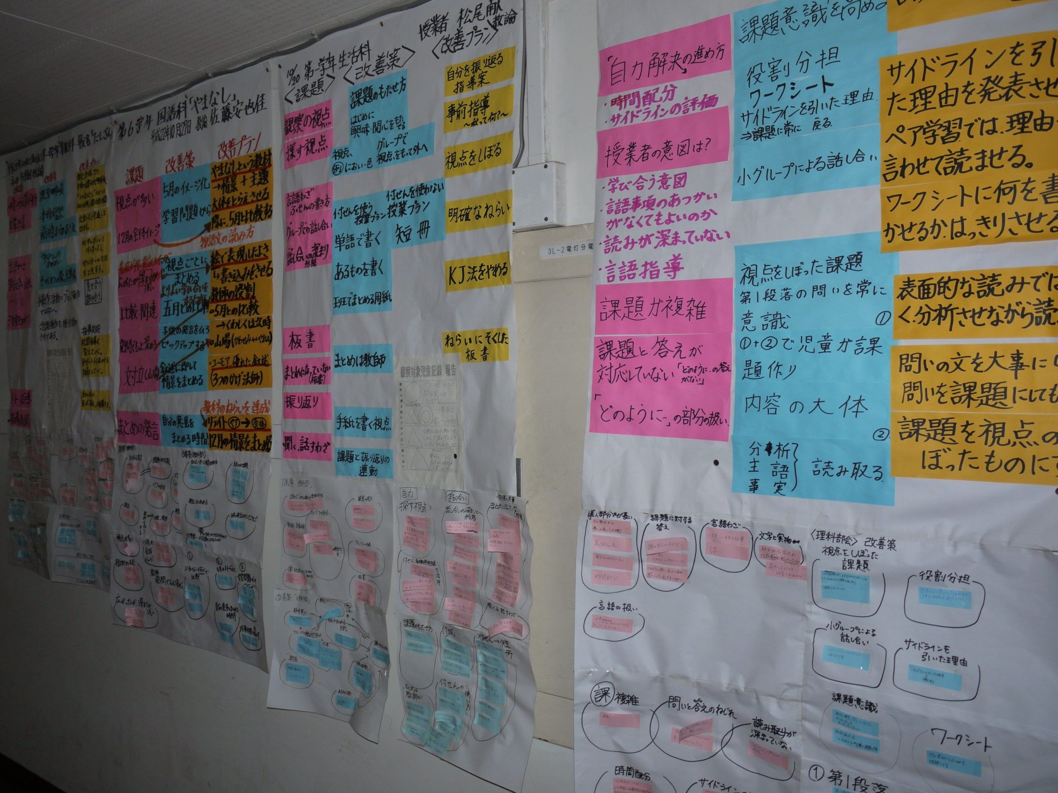
Tomoko TAMURA
The teachers of this school have such lesson studies once a week; thus, there are many charts on the corridor walls.
Notes:
The teachers of this school have such lesson studies once a week; thus, there are many charts on the corridor walls.
These products express to the students and the parents the teachers’ efforts to create good lessons.
The teachers are proud of what they do; thus, they do not think that these charts are too large.
They have no difficulty in storing them.

Slide 6
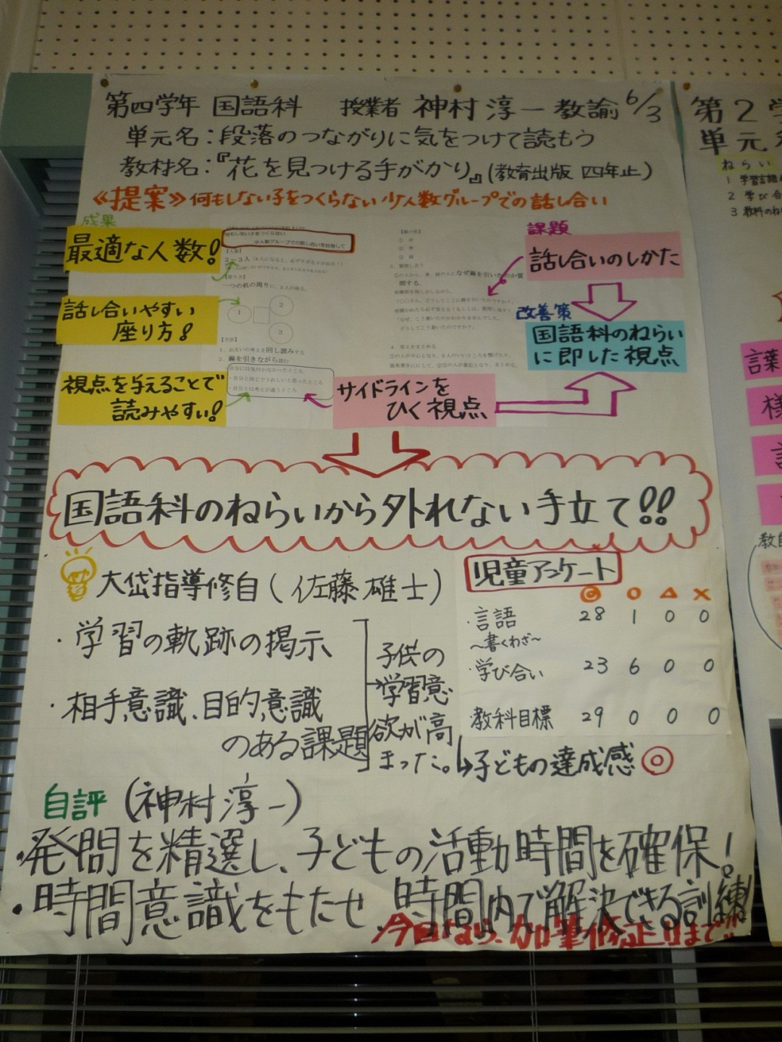
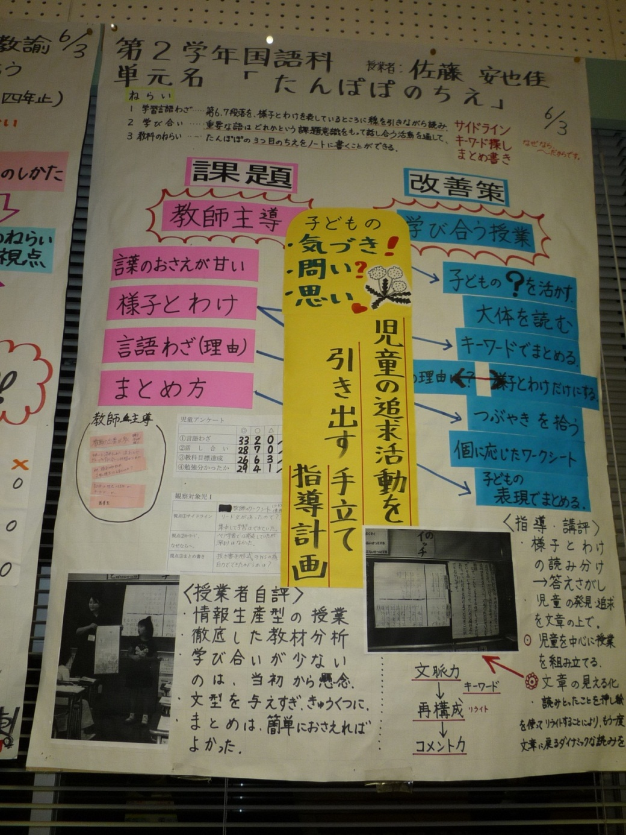
Tomoko TAMURA
the blueprints of revised lesson plans
Notes:
These pictures also show the blueprints of revised lesson plans made in this school.
The important point of the WSLS in this school is to make improvements in the blueprints of lessons.
If they do not do this, they might think lesson studies would be a waste of time.

